Slide 1

The Enigma Simulator
Elliot Brooks
Notes:
Hello, my name is Elliot, and this a video about my project : The Enigma Simulator.

Slide 2
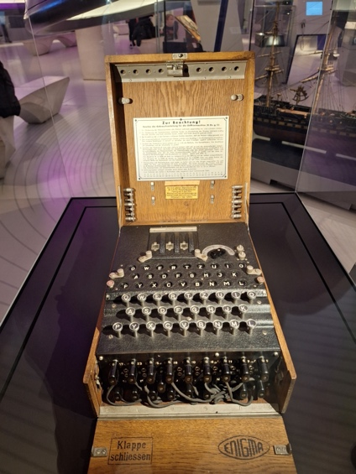
What is Enigma?
A mechanical/electrical cypher machine
Used extensively during WW2
Large part of history/cryptography/computer science

Slide 3
How does Enigma work?
Electrical Signals
Mechanics
Each component redirects electrical signals, encoding the input
The choice of components and their settings forms the Enigma’s Key
Rotors rotate every keypress
Causing wiring to change
Causing letter mapping to change
One letter can be encrypted to multiple different letters in a single message
Up to x9 letter scrambling!

Slide 4
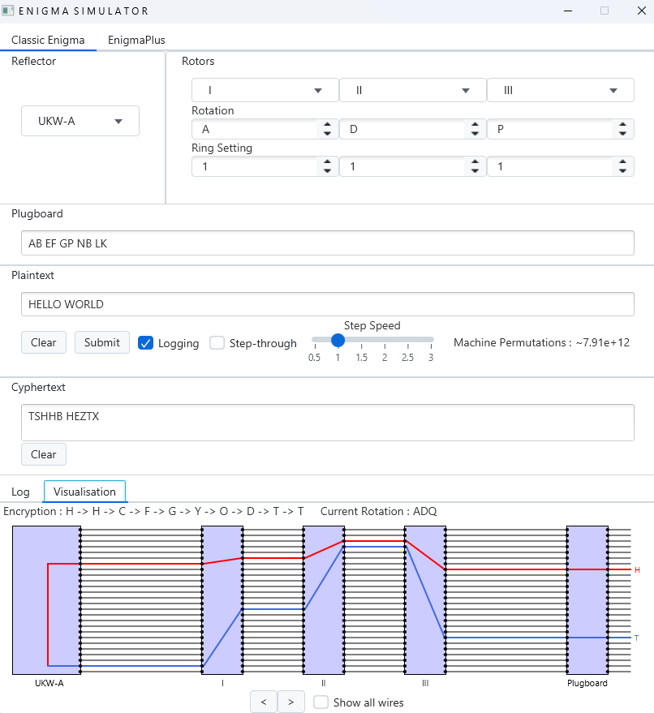
What is The Enigma Simulator?
Accurate recreation of Enigma
Allow the user to create custom components
An improved model “EnigmaPlus”
Fixes the flaws of Enigma
Quick and easy to use command line interface
Interactive and educational GUI
Real-time visualisation

Slide 5
How did I do it?
Planning
Implementation
Evaluation
Entire project stored within GitHub repository
https://github.com/elliot-brooks/enigma-simulator
Feature planning took place within GitHub Issue tracker
Java application
Maven build tool
JavaFX graphics package
XML database (custom components)
Modern software engineering design principles
Comparison against other similar products
Unit tests and test coverage
Decoded genuine Enigma messages from WW2

Slide 6
Results

Slide 7
Conclusions
What works?
Provides a complete and authentic enigma experience
Helps encourage exploration with the Enigma machine
Provides useful insights such as visualisation
Aesthetically pleasing
Multi-platform
How could it be better?
Allow for further customisation
Expand the cyphers alphabet
Generate animations
Provide more background information
Simulate the Turing Welchman Bombe (Future Work)

